Slide 1
Privacy by Design
Certification Program 2.0
Sylvia Klasovec Kingsmill, BA, LLB
Partner, Global Privacy Solutions Lead
National Privacy, Regulatory & Information Management Lead

Slide 2
Privacy by Design: The Seven Principles
Proactive not reactive:
preventative not remedial
1
2
Privacy as the default setting: no additional action required
3
Privacy embedded into design:
not just an add-on
Privacy by Design is structured around 7 Foundational Principles developed by Dr. Ann Cavoukian, former Canadian privacy regulator collaborating with KPMG in Canada to roll out privacy certifications under ISO 31700
4
Full functionality:
positive-sum, not zero-sum
5
End-to-end security:
full lifecycle protection
6
Visibility and transparency:
keep it open
7
Respect for user privacy:
keep it user-centric

Slide 3
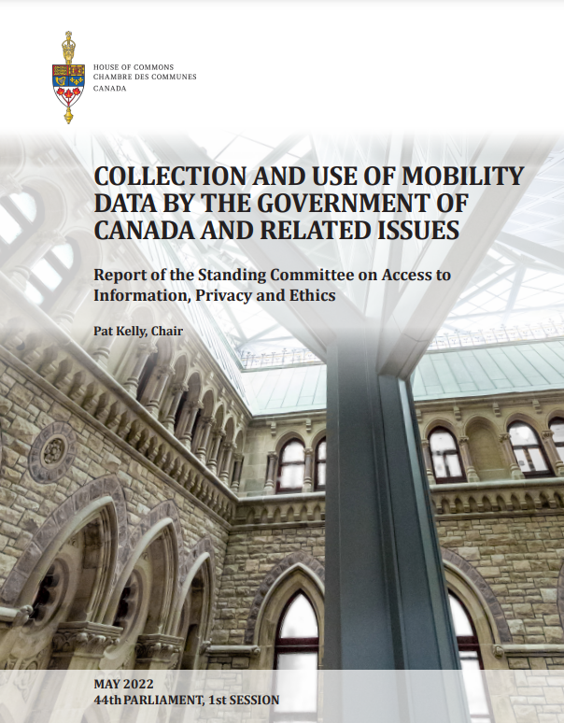
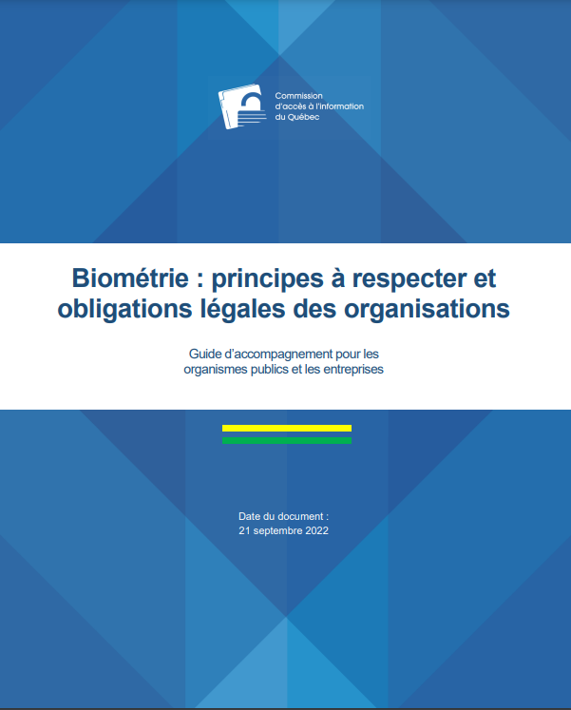
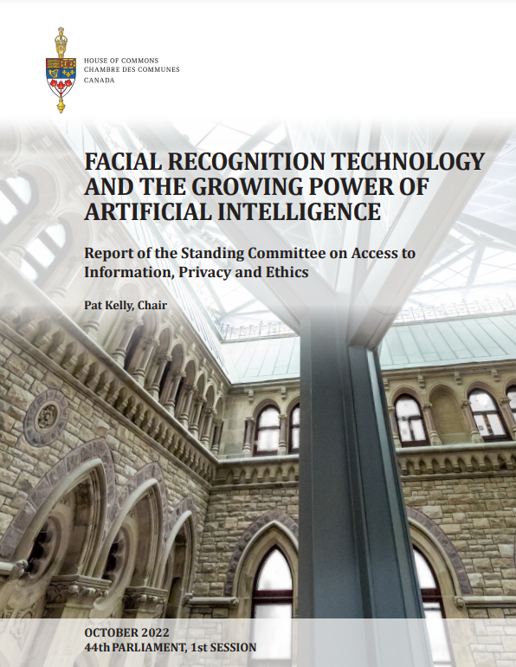
An Evolving Landscape
KPMG has been pro-actively monitoring the ever changing privacy landscape to adapt our proprietary Privacy by Design (PbD) Assessment Framework for assessment and/or certification of ISO 31700.
The PbD Assessment and/or Certification in effect provides a defensible position against regulatory and/or public scrutiny.

Slide 4



Overview of Various ISO/IEC Privacy Standards – Spotlight on ISO 31700
FRAMEWORK
ISO/IEC 29100
Privacy Framework w/ Privacy Principles
MANAGEMENT
ISO/IEC 29134
Privacy Impact Assessment
ISO/IEC 29190
Privacy Capability Assessment Model
ISO/IEC 29184
Online Privacy Notices and Consent
Risks
Maturity Levels
Notices
ALL
PII CONTROLLER
PII PROCESSOR
ISO/IEC 27001
Information Security Management System
ISO/IE
Privacy Information
C 27701
Management System
CONTROLS
ISO/IEC 29151
Code of practice for personally identifiable information protection
ISO/IEC 27018
Code of practice for protection of personally identifiabl e
information (PII) in public clouds acting as PII processors
ISO/IEC 27002
Code of practice for Information Security
TECHNOLOGY
ISO/IEC 29101
Privacy architecture framework
ISO/IEC 20899
Privacy enhancing data de- identification terms. and classification of techniques
ISO/IEC 29191
Requirements for partially anonymous, partially unlinkable authentication
PRIVACY BY DESIGN
ISO/IEC TR 27550
Privacy engineering for system lifecycle
processes
ISO/IEC TS 27570
Privacy guidelines for smart cities
ISO/IEC CD 27556.2
User-centric framework for the handling of personally
identifiable information (PII) based on privacy preferences
ISO 31700
Consumer protection — Privacy by design for consumer goods and services

Slide 5


KPMG’s Alliance with MSECB
KPMG together with Dr. Ann Cavoukian has partnered with MSECB Management Systems Inc. (MSECB) to offer a Privacy by Design Certification Program. KPMG is the exclusive assessment arm for ISO 31700 Privacy by Design certification by PECB MS.
MSECB helps organizations show commitment by providing them with valuable audit and certification services against internationally recognized standards. They are accredited against ISO/IEC 17021:2015, are a Corporate Member of CSA and also a Member of the IAAR. MSECB provides non-accredited certification against ISO 31700 Privacy By Design.
  MSECB is specialized in the certification of management systems and processes on a wide range of international standards. As a global accredited provider of audit and certification services, MSECB offers its expertise on multiple fields, including but not limited to Information Security, IT, Business Continuity, Service Management, Quality Management Systems, Risk Management, Health, Safety, and Environment and privacy: www.msecb.com

Slide 6














Privacy by Design Adopters

Slide 7
PbD Refresh – Version 2.0
KPMG has enhanced its proprietary Privacy by Design Assessment Framework to ensure a proactive risk based approach focusing on data lifecycle risks. The PbD Framework harmonizes legal requirements, including Bill C-27, Law 25, international law (e.g. GDPR) and regulatory expectations on facial recognition, artificial intelligence, and digital ID services.
1
Proactive not reactive
7 Principles | Assessment criteria | Illustrative controls
Principle 1 | 1-9 | 1-23
Principle 2 | 10-15 | 24-36
Principle 3 | 16-19 | 37-44
Principle 4 | 20 | 45-47
Principle 5 | 21-30 | 48-75
Principle 6 | 31-33 | 76-92
Principle 7 | 34-37 | 93-107
Total | 32 criteria | Up to 107 controls
2
Privacy as the default setting
3
Privacy embedded into design
4
Full functionality
5
End-to-end security
6
Visibility and transparency
7
Respect for user privacy

Slide 8
Comply Once Attest to Many
KPMG has streamlined and updated its mapping to include new Canadian privacy laws and regulatory guidance.

Slide 9
Detailed List of Controls
Legend
Net new control
Principle 1 – Proactive not reactive; preventative not remedial
Criteria | Control # | Controls
1.1 Privacy Governance - Responsibility and Accountability for Policies and Procedures | 1.1.1 | Designated Individual Responsible for Privacy (“Privacy Officer”)
 | 1.1.2 | Documented Roles and Responsibilities for Privacy
 | 1.1.3 | Formally Documented Privacy Management Program
 | 1.1.4 | Regulatory Interactions
1.2 Privacy Impact Assessments or Privacy Risk Reviews | 1.2.1 | Privacy Assessment Process
 | 1.2.2 | Documented Privacy Assessment, Recommendations and Roadmap
 | 1.2.3 | Data Sharing Assessment
 | 1.2.3 | Algorithmic Impact Assessments
 | 1.2.4 | Re-identification Risk Assessments
1.3 Compliance, Monitoring and Enforcement | 1.3.1 | Review / Approval of Privacy-Related Policies, Standards and Processes
 | 1.3.3 | Control Testing & Monitoring
 | 1.3.4 | Oversight of Control Testing & Monitoring
 | 1.3.5 | Tracking Privacy Risks and Remediation Activities
1.4 Consistency of Privacy Policies and Procedures With Laws and Regulations | 1.4.1 | Consistency of Privacy Policies with Laws, Regulations and Industry Standards
1.5 Privacy Training & Awareness | 1.5.1 | Privacy Training / Awareness
 | 1.5.2 | Qualifications of Privacy Staff
1.6 Organizational Change Management | 1.6.1 | Organizational Change Management
1.7 Third Party Protection of Personal Information | 1.7.1 | Due Diligence
 | 1.7.2 | Third Party Agreements
 | 1.7.3 | Review of Third Party Controls
1.8 Cross-border Transfer of Personal Information | 1.8.1 | Transfer Risk Assessments
 | 1.8.2 | Safeguards for Cross-border Transfer
1.9 Data Strategy | 1.9.1 | Data Strategy

Slide 10
Detailed List of Controls
Legend
Net new control
Principle 2 – Privacy as the Default
Criteria | Control # | Controls
2.1 Privacy Settings by Default | 2.1.1 | Privacy User Settings
 | 2.1.2 | Configuration Defaulted to the Privacy Protected State
2.2 Data Minimization: Collection Limited to Identified Purpose | 2.2.1 | Systems and Procedures to Limit Collection
 | 2.2.2 | Periodic Review to Ensure Limited and Lawful Collection
2.3 Use of Personal Information | 2.3.1 | Systems and Procedures to Limit Use
 | 2.3.2 | Use in Agreement with Identified Purpose
 | 2.3.3 | Use in Compliance with Laws and Regulations
 | 2.3.4 | New Purposes and Uses
2.4 Retention, Storage, and Disposition of Personal Information | 2.4.1 | Retention and Destruction Policies and Procedures
 | 2.4.2 | Destruction in Accordance with Policies and Procedures
 | 2.4.3 | Certificate of Destruction
2.5 De-Identification and Anonymization | 2.5.1 | Anonymization and Similar Techniques to Avoid Use of PI
 | 2.5.2 | De-identification/Pseudonymization Procedures to Limit Use
Principle 3 - Privacy Embedded into Design
Criteria | Control # | Controls
3.1 Consideration of Privacy in Design Documentation | 3.1.1 | Threat Modelling
 | 3.1.2 | Technical and Solution Design Documents
 | 3.1.3 | Coding, Architecture, and Configuration
 | 3.1.4 | Testing and Validating Controls
 | 3.1.5 | Continuous Integration and Feedback Loops
 | 3.1.6 | Scalability Requirements
3.2 Tech Enablement | 3.2.1 | Privacy Enhancing Technologies (PETs)
3.3 IT Change Management | 3.3.1 | IT Change Management

Slide 11
Detailed List of Controls
Legend
Net new control
Principle 4 – Full functionality – positive sum, not zero sum
Criteria | Control # | Controls
4.1 Positive Sum | 4.1.1 | Limit Unnecessary Trade-Offs
 | 4.1.2 | Favour User-Centred Design Choices
 | 4.1.3 | Offer Full Functionality
Principle 5 – End-to-end security – Full Lifecycle Protection
Criteria | Control # | Controls
5.1 Information Security Program | 5.1.1 | Security Program
 | 5.1.2 | Information Security Policy
 | 5.1.3 | Documented Security Safeguards
 | 5.1.4 | Security Roles & Responsibilities
 | 5.1.5 | HR Information Security
 | 5.1.6 | Security Awareness and Training
5.2 Data Lifecycle Management | 5.2.1 | Inventory and Data Mapping
 | 5.2.2 | Data Classification
 | 5.2.3 | End of Life Disposal and Destruction
5.3 Logical Access to Personal Information | 5.3.1 | Identity and Access Management
 | 5.3.2 | Role-Based and Attribute-Based Access Control (RBAC/ABAC)
 | 5.3.3 | Remote Access to Personal Information
5.4 System Logging and Monitoring | 5.4.1 | User Access Logs
 | 5.4.2 | Protection of Log Information
5.5 On-Premise and Cloud Environments | 5.5.1 | Secured Areas
 | 5.5.2 | Personal Information Transmitted by Physical Means
 | 5.5.3 | Cloud Security

Slide 12
Detailed List of Controls
Legend
Net new control
Principle 5 – End-to-end security – Full Lifecycle Protection
Criteria | Control # | Controls
5.6 Network Security | 5.6.1 | Encryption
 | 5.6.2 | External Network Connections
5.7 Security Assurance Testing | 5.7.1 | Threat and Vulnerability Testing
 | 5.7.2 | Audit and Assurance
 | 5.7.3 | Security Reporting
5.8 Business Continuity and Disaster Recovery | 5.8.1 | Routine Back-ups
 | 5.8.2 | Annual Testing of Disaster Recovery
 | 5.8.3 | Business Continuity and Disaster Recovery Procedure
5.9 Incident and Breach Management | 5.9.1 | Incident Response and Breach Management Procedure
 | 5.9.2 | Annual Tabletop Exercise
 | 5.9.3 | Breach recordkeeping requirements
Principle 6 – Visibility and Transparency – Keep it Open
Criteria | Control # | Controls
6.1 Information for Individuals | 6.1.1 | Purpose for collection
 | 6.1.2 | The Source of PI
 | 6.1.3 | The PI held by the Organization
 | 6.1.4 | Method of Collection
 | 6.1.5 | Categories of Persons with Internal Access
 | 6.1.6 | Information on the Exercise of Individual Rights
 | 6.1.7 | Use of Profiling, Geolocating, Identification or Similar Technologies
 | 6.1.8 | Third Parties and Sharing of PI
 | 6.1.9 | Transfer of PI Outside the Jurisdiction
 | 6.1.10 | The Retention Period of the PI
 | 6.1.11 | Contact Information for the Designated Individual
 | 6.1.12 | Inquiries and Complaints
 | 6.1.13 | Automated Decision Making
 | 6.1.14 | Lending or Credit Decisions

Slide 13
Detailed List of Controls
Legend
Net new control
Principle 6 – Visibility and Transparency – Keep it Open
Criteria | Control # | Controls
6.2 Timing and Mode of Communication | 6.2.1 | Timing of Notice
 | 6.2.2 | Delivered in User-Friendly Manner
 | 6.2.3 | Delivered in Clear, Simple Terms
Principle 7 – Respect for User Privacy – Keep it User-Centric
Criteria | Control # | Controls
7.1 Lawful and Fair Use | 7.1.1 | Appropriate and Defined Purpose
 | 7.1.2 | Consent
 | 7.1.3 | Consent Alternatives
 | 7.1.4 | User-Centred Design Strategy
 | 7.1.5 | Consent and Preference Management
7.2 Individual Rights | 7.2.1 | Access to Personal Information
 | 7.2.2 | Data Portability
 | 7.2.3 | Correction of Personal Information
 | 7.2.4 | Deletion or Erasure of Personal Information
 | 7.2.5 | De-Indexing / Re-Indexing
 | 7.2.6 | Objection to Processing
 | 7.2.7 | Explanation or Review of Decision
 | 7.2.8 | Handling Inquiries and Complaints
7.3 Accuracy | 7.3.1 | Accuracy of Personal Information
 | 7.3.2 | Accuracy of Credit Reporting Information

Slide 14
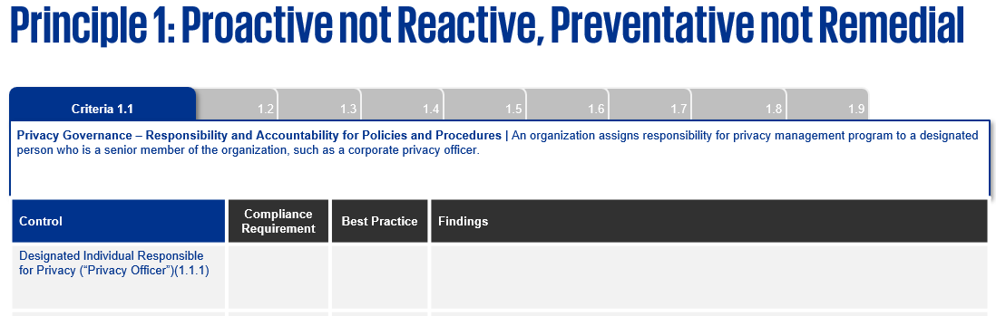
How to Read the PbD 2.0 Report
The report is organized around the 7 Foundational Principles of Privacy by Design. Under each principle, the report will summarize:
the privacy “assessment criteria” (e.g. group of controls based on harmonized legal requirements);
the description of the “control” (e.g. the means by which to demonstrate compliance with the assessment criteria);
the “compliance requirement” in terms of whether the “control is met”, which is marked with a “✓”, or “not met” marked with a “✗”, or “partially met” marked as “partially met”, or “N/A” if the control does not apply or is out of scope;
whether the control that is being met goes beyond legal compliance and is considered “best practice” that sets the organization over and above its peers and/or industry best practice(s); and
the “findings” (e.g. the deficiencies / gaps in compliance and/or industry standards/practice(s)) which result into a “control not being met”.
Principle
Assessment Criteria
Assessment criteria
Control
✓
Control is met, not met, partially met or N/A
For example, it is a best practice to use multifactor authentication (versus industry use of two factor authentication)
Findings / Gaps
Distinguishes best practice(s) that go beyond mere compliance (“should” versus “must”)

Slide 15
Our Privacy by Design Approach
KPMG takes a holistic approach in conducting a Privacy by Design Assessment
Objective
Identify and remediate privacy risks by understanding current state of privacy and data protection
Scope & Approach
Assess an organization’s product, service, process or system against Privacy by Design principles and related Privacy by Design Assessment Framework
Deploy an assessment team of multi-disciplinary privacy and security professionals, including technologists and privacy lawyers
Methodology
Analyze technology and related architecture, data flows, supporting policy and governance documents, corroborated by interviews
Evaluate whether the privacy or security control(s) exist and are designed properly

Slide 16
Evaluation Criteria
KPMG will assess an organization’s overall privacy risk posture by examining controls in 4 domains that typically operate in silos increasing privacy risk exposures:
People
e.g. common pitfalls arising from lack of employee awareness, management support, availability of guidelines and manuals, and mechanisms for communicating information handling and privacy practices
Process
e.g. the type of personal information collected, the purposes of its collection, how information protection is ensured operationally throughout the data lifecycle (from collection to destruction), irrespective of whether the data is paper based or in electronic format
Governance
e.g. tone from the top, accountability framework, and corporate culture to demonstrate how privacy is top of mind for the organization, aligned with strategic objectives and embedded into day-to-day operations
Technology
e.g. the IT environment and infrastructure that supports the collection, transmission and/or storage of personal information, and the security controls in place to safeguard the data

Slide 17

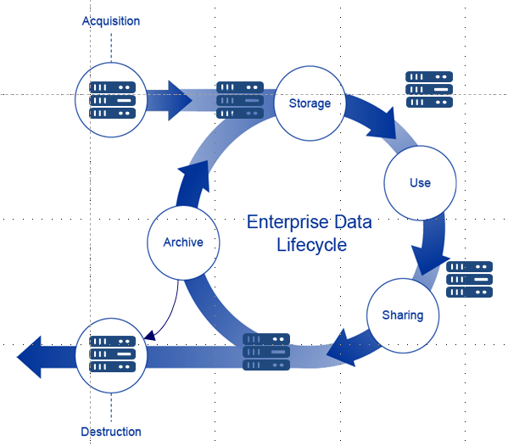

Data Lifecycle Review
  Identify the types of personal information collected and its associated business purpose, considering purpose limitation, consent, etc.
  Identify privacy risks throughout the data lifecycle, from cradle to grave, focusing on security, information handling, user control, transparency.
Business Process
Name and
address
Location data
Credit card information
Employee data
Email address, IP address
Mobile and device data
15

Slide 18
Estimated Fees & Engagement Process

Slide 19

Assessment and Certification Fees
The estimated timing and professional fees charged by KPMG for the assessment portion of the engagement will be based on:
Scope for Assessment
Organization
Systems
Documentation
Stakeholders
Number of in-scope: products, systems, initiatives, processes, platforms, or programs
Size, complexity of organization, and jurisdiction(s) of operations
Number and complexity of IT systems
Number of documents to be reviewed
Number of stakeholders to be interviewed
Note: this fee does not include any required remediation work to close identified privacy gaps.
Assuming that privacy gaps are closed and the organization receives a ‘satisfactory’ rating, MSECB will charge an initial certification fee of
Certification can be renewed annually for two (2) additional years, provided there are no material changes, for a renewal fee of
The timeline for certification by MSECB may take up to two weeks
2
Weeks
$5,000 – 10,000
$1,250
2
Renewals may take up to two (2) business days
per year
Days

Slide 20
Process Overview
Assessment and Certification Steps
Step 1: Assess
Step 2: Certify
Respond to assessment recommendations
Applicant
PECB MS
Certify
End
Assess then Certify
Conduct assessment; Issue preliminary report
KPMG
Finalize
assessment report
Refer to KPMG

Slide 21
The KPMG Engagement
KPMG conducts the assessment before certification can be issued by MSECB
Step 1
KPMG Engagement
KPMG assesses a technology, product or service and issues a report
1) Introduction to MSECB: KPMG introduces client to MSECB to sign application form and complete terms and conditions
2) Kick-off: Engagement scoping/planning, initial meeting and collection of documents
3) Assessment: Interviews with key personnel/reviewing current system design controls and information handling practices
Step 2
MSECB reviews the report and if satisfied on its own ISO based criteria, issues a privacy certification seal which is valid for three years
4) Report Writing and Close Out: Report preparation of the assessment results with recommendations for certification to MSECB

Slide 22
The MSECB Process
Once a “clean” Privacy by Design Assessment Report is issued by KPMG, the next step is to get a Certification Seal from MSECB
Step 1
Step 2 (Year 1 & 2)
MSECB will review KPMG’s Privacy by Design Assessment Report and if satisfied on its own criteria will issue a Certification Seal (1-2 weeks)
On the first and second year anniversary of receiving a Certification Seal, a Self-Attestation Questionnaire must be submitted to MSECB confirming there has been no material change
A Privacy by Design re-assessment, by KPMG, is necessary if there is a material change to the product or service offering.
If Material Change
No Material Change
Step 3 (Year 3)
After three years, the Certification Seal expires and KPMG needs to conduct a re-assessment followed by MSECB’s review (Step 1 of MSECB Process)

