Slide 1
Pitfalls to Avoid:
Common Mistakes in the
ISO/IEC 27001 & ISO/IEC 27701 Certification Journey
By Mostafa AlShamy

Slide 2
Webinar Agenda
A Brief Explanation of Certification Journey
Pitfalls to Avoid
Q&A
Page 2
Notes:
CertificationSSSSSSS

Slide 3
MSECB Webinar
Background of
Mostafa AlShamy
Mostafa AlShamy is a trainer, assessor, consultant, and then auditor with more than 20 years of experience in GRC and respective fields, including but not limited to SMS, ISMS/PIMS, BCMS, RM, Data Governance, and Management.
In the last six years, he has conducted tens of audits on behalf of MSECB over four continents. Through his experience, he has helped many organizations express their commitment to quality and continuous improvement.
malshamy@ofouqis.com
https://www.linkedin.com/in/malshamy/

Slide 4
A Brief Explanation
of Certification
Journey

Slide 5
Prior Certification Journey
Organizations have a lot of work to do before the certification audit, including but not limited to:
Obtain management support for Management System (MS) lifecycle
Define scope and management intention after reviewing your organization’s service catalogue
Identify requirements and responsibilities
Develop training and awareness programs
Design the process of risk management and perform risk assessment and treatment
Build the MS and implement all required controls
Operate the MS
Conduct internal audits
Perform management review
Page 5

Slide 6
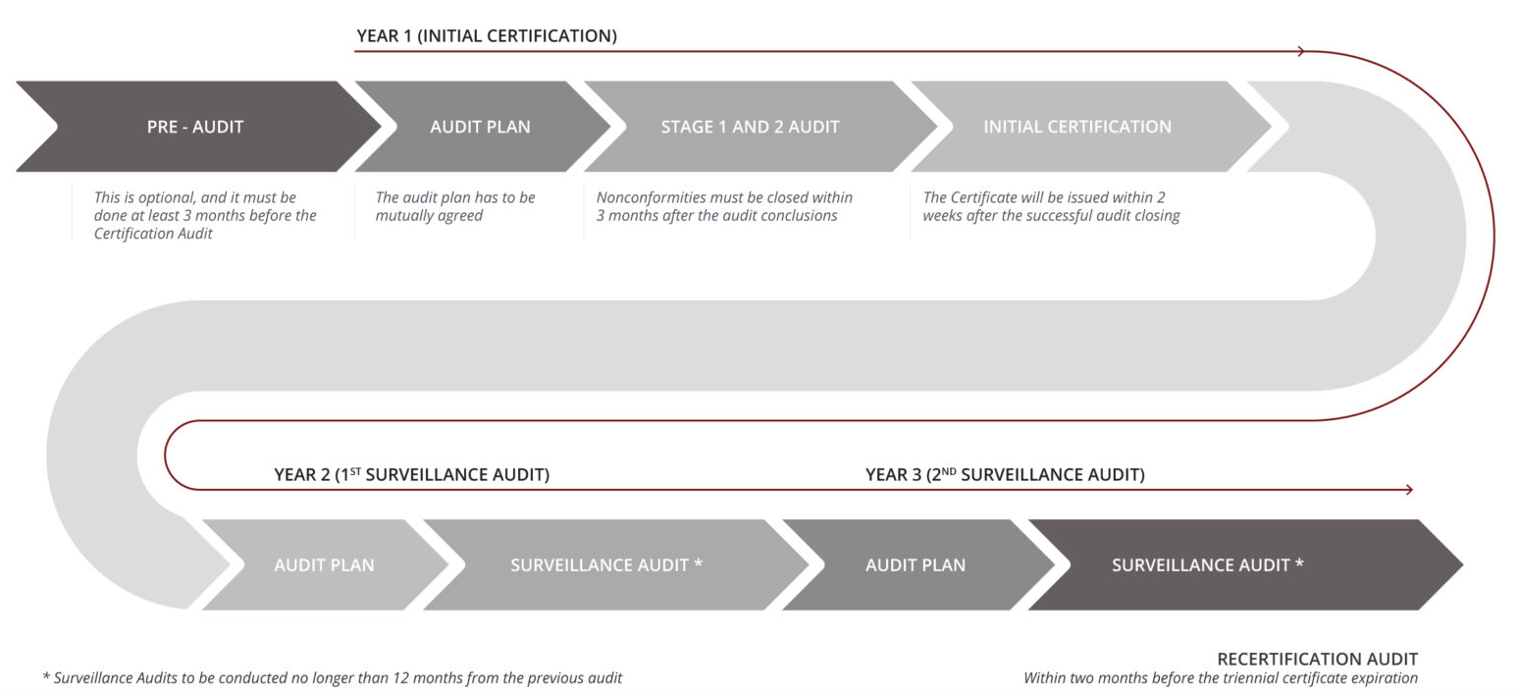
MSECB’s Certification Journey

Slide 7
MSECB Webinar
Post Certification Journey
Organizations have a lot of work to do to update the MS accordingly after the certification audit, including but not limited to:
MS components continual improvement
MS objectives and KPIs continual measurement
Internal audit (at least once per year)
Management review (at least once per year)
Continuous awareness and training
Managing MS changes (MS is dynamic and not static)
Etc…

Slide 8
Pitfalls to
Avoid

Slide 9
Pitfalls to Avoid: Prior Certification Journey
Right Scope (Locations, DRS, branches, services, functions, …)
Which Type of Personal Data to Cover (Employees, customers, or both.)
Personal Data Lifecycle
Consent and Announcements
Incidents and Breaches
Competence vs. Awareness
Risks vs. Opportunities
Document Management System
Internal Audit (Who shall conduct it, when, and what are the criteria?)
Management Review

Slide 10
Pitfalls to Avoid: Prior Certification Journey
Wrong scope (locations, DRS, branches, services, functions, …)
Wrong type of personal data to cover (employees, customers, or both)
Partial personal data lifecycle
Forget consent and announcements in addition to regulators
Not prepared for incidents and breaches
Not sufficient or proper training or awareness
Discover risks and forget opportunities
Not unified Document Management System (DMS)(structure, validity, review,..Ect)
Self-internal audit (Who shall conduct it, when, and what are the criteria?)
Management review for technical aspects
Paying the audit fees means having the certificate for sure

Slide 11
MSECB Webinar
Pitfalls to Avoid: Post Certification Journey
Improper certification announcement
Misunderstanding certification for regulatory compliance
Neglecting MS regular maintenance activities including documented information review and update
Lacking MS continuous improvement
Neglecting last audit nonconformities and corrective actions
1st Surveillance shall be before 12 months from the certification audit; 2nd Surveillance before 24 months, and Recertification before 36 months.

Slide 12
Q&A

Slide 13
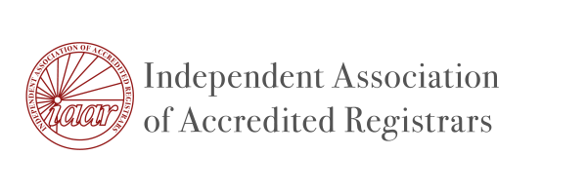
MSECB Webinar
About MSECB
Management System Certifications
MSECB is an IAS-accredited certification body for management systems on various international standards.
Furthermore, MSECB, as a Corporate Member of the Cloud Security Alliance (CSA), offers Level 2 STAR Certification in conjunction with ISO/IEC 27001.
We are also proud members of the Independent Association of Accredited Registrars (IAAR), a member-driven organization promoting accredited management system certification.
Information Security and Privacy
Quality, HSE, and Sustainability
Corporate Governance and Resilience

Slide 14
Thank you for your attention!
Stay updated!
+1 (450) 328-1227
info@msecb.com
www.msecb.com

