Slide 1
The Price of Success: Unlocking the Rewards of ISO Certifications
By Rinske Geerlings

Slide 2
Webinar
Agenda
Presentation
The Price of Success: Unlocking the Rewards of ISO Certifications
Q&A
Page 2
Notes:
CertificationSSSSSSS

Slide 3
MSECB Webinar
Background
Rinske Geerlings
Multi-award winning consultant, trainer, and auditor in Business Continuity (BCM), IT Management, Information Security, and Risk Management
ISO 22301, ISO/IEC 27001, ISO 22361, ISO 22316, and ISO 31000 certified
Consulted for 20+ years to 100s of Government entities, SMEs, and larger corporates across Australasia, Africa, Europe, and Latin America
Risk Consultant of the Year 2017 by RMIA (Australasia)
Outstanding Security Consultant of the Year 2019 Finalist in the OSPAs
Australian Business Woman of the Year 2010-13 by BPW (global NGO)
Alumnus of the Year 2013 (Delft University, Netherlands)
Board Member (ARVP) of ASIS International – Australasia region
Specific regulatory experience - Australian Prudential Regulation Authority (APRA)

Slide 4
Client Sample

Slide 5
Why being a certified auditor matters?
Professional Credibility
Increased Job Opportunities
Career Advancement
Networking/Relationships
Confidence
Continuing Professional Development

Slide 6
Generic benefits of organizational certification
1. Improved quality and efficiency
Streamlined internal processes, reduced errors and increased operational efficiency.
Improved product or service quality.
2. Enhanced credibility
Meet internationally recognized standards for quality, safety, or environmental management.
Enhances the organization's reputation and credibility in the eyes of customers, partners, and stakeholders – including staff!
3. Expanding into new markets
Open doors to new markets and business opportunities.
Often a prerequisite for doing business.
Competitive edge when bidding for contracts.
International opportunities.
Page 6

Slide 7
Generic benefits of
organizational certification (cont.)
4. Legal and regulatory compliance
Align processes with legal and regulatory requirements.
Ensure compliance with applicable laws, regulations, and industry-specific guidelines.
Reduced risk of penalties, fines, and other legal issues.
5. Happier customers
Enhanced understanding of customer needs and improved communication.
Delivery of products or services that consistently meet or exceed expectations.
Increased customer satisfaction and loyalty.
Page 7

Slide 8
Generic benefits of
organizational certification (cont.)
6. Proactive risk management
ISO standards incorporate risk-based thinking and emphasize proactive risk management
Identify, assess, and mitigate risks more effectively
Preventing incidents, minimizing disruptions, and protecting reputation and assets.
7. Continuous improvement culture
Commit to monitoring and evaluating their processes, identifying areas for improvement, and implementing corrective actions
Mindset of ongoing learning, innovation, and adaptability, resulting in long-term success.
Page 8

Slide 9
MSECB Webinar
The Price of Success
1. Internal resourcing and upskilling
3. Consultancy
External expertise and support in implementing processes aligned with the standard(s).
Internal audits and preparing for the certification audit.
Attracting new (or re-allocating existing) staff to implement and ongoingly maintain the process(es).
Training and education related to the specific ISO standard being pursued.
Registration fees, materials, and the time investment for employees to attend.
Cost varies depending on:
Size and complexity of the organization
Maturity level of existing processes pre-certification
Type of ISO standard being pursued
Any standards being implemented in conjunction
Chosen certification body
Consider…
4. Fees of the certification body
Initial certification audit.
Surveillance audits.
Recertification audits.
2. Implementation costs and efforts
Any necessary organizational/procedural changes or improvements to existing processes.
Investments in technology, equipment, and infrastructure to support the process.
5. No long-term commitment
Tick-box approach.
Money and effort wasted.

Slide 10
Case Study
Manufacturing Sector
Porducts #2

Slide 11
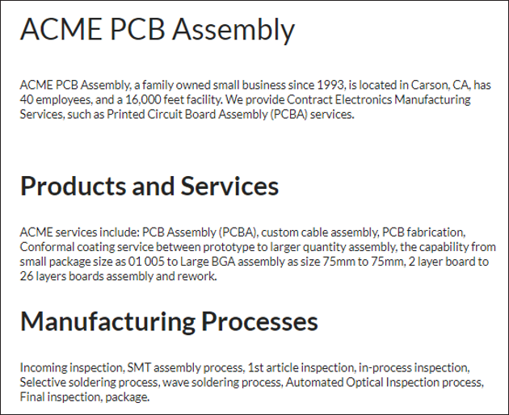
Case Study
Manufacturing Sector
(cont.)

Slide 12
Case Study
Manufacturing Sector
(cont.)
Milestones
1995 – ACME PCB Assembly offers Ball Grid Array (BGA) assembly
2000 – ACME PCB Assembly is ISO 9001:2000 certified
2004 – ACME PCB Assembly offers Lead-Free (RoHS) PCB assembly
2005 – Procured another Fuji NXT pick-and-place machine for prototype and high-mixed, low-quantity builds
2006 – Institute for Printed Circuits (IPC) 610 Class III certified
2007 – IPC J-STD-001 Class III certified
2008 – Upgraded operation to ISO 9001:2008
2009 – Added SeHo Selective Soldering Machine
2010 – Added Nordson Automatic Optical Inspection system
2011 – Added Schleuniger Cable Stripping machine
2012 – ACME PCB Assembly offers Conformal Coating service
2014 – Acquired new 130 kV X-ray inspection machine for counterfeit-component inspection, another 650XL rework machine, and BGA microscope inspection tool
2015 – Added Schleuniger cable stripping machine
2016 – Awarded Business Hall of Fame Best of 2014, 2015, 2016, for Printed Circuit Board Assembly.
2017 – Environmental Management Systems – ISO 14001:2015 Certified. Upgraded to ISO 9001:2015
2018 – Awarded Small Business Excellence Award
2018 - Awarded Business Hall of Fame best of 2018

Slide 13
1
Employee engagement and safety
ISO certifications related to occupational health and safety, such as ISO 45001, prioritize employee well-being and safety. Manufacturing companies that achieve ISO certification demonstrate their commitment to providing a safe working environment for their employees. This can lead to increased employee engagement, morale, and productivity.
Specific Benefits of ISO for the Manufacturing Sector
2
Improved product quality
Particularly, ISO 9001 (Quality Management System) emphasizes the importance of quality control and continuous improvement. Benefits include improving product quality, reducing defects, and consistently meeting customer expectations, thus increasing customer satisfaction and loyalty.
3
Enhanced operational efficiency
ISO standards focus on optimizing processes by implementing efficient workflows and standardized procedures, effective resource management, improving operational efficiency, minimizing production errors, reducing waste, and reducing costs.

Slide 14
4
Supply chain optimization
ISO certification can lead to improved relationships with suppliers and customers. Manufacturers with ISO certification are seen as reliable partners who prioritize quality, consistency, and compliance. This can result in stronger supply chain collaboration, reduced supply chain risks, and improved overall efficiency.
5
Compliance with regulatory requirements
Specific Benefits of ISO for the Manufacturing Sector
The manufacturing sector is subject to various legal and regulatory obligations related to quality, safety, and environmental management. ISO certification, such as ISO 14001 (Environmental Management System) or ISO 45001 (Occupational Health and Safety Management System), helps manufacturers ensure compliance with these requirements, mitigate risks, and avoid penalties or legal issues.
6
Increased market access and global competitiveness
ISO certification is often a prerequisite for doing business with many organizations, including government entities and large corporations. Achieving ISO certification demonstrates a manufacturer's commitment to international standards and quality management, increasing their opportunities for market expansion and access to global supply chains.

Slide 15
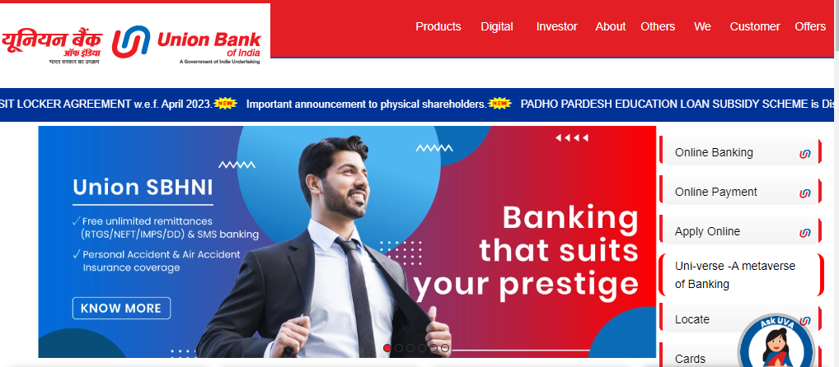
Case Study
Finance Sector
Porducts #2

Slide 16
Case Study Finance Sector (cont.)
Awarded By | Awards | Awarded For
IBA Banking Technology Awards 2022 | Winner in large banks category (Private and Public) | Best Technology Bank
 |  | Best IT Risk Management
 |  | Best Technology Talent
 | Runner-up (large banks category both private and public) | Best AI & ML Bank
 |  | Best Financial Inclusion
 | Special Award | Best Fintech Collaboration
IDC | Future Enterprise Awards 2022 | Future Enterprise of the year
Asia Trailblazer Awards | Retail Banker International Asia Trailblazer Awards 2022 | Best ATM and Self-Service Innovation for WhatsApp Banking (UVConn)
Governance Now | 5th India BFSI Awards 2022 | Use of Emerging Technologies
Exito | Digital Transformation Summit 2022 | Digital Transformation
Mint Awards | TechCircle Business Transformation Awards 2022 | Revenue Generation (Customer Experience)

Slide 17
Case Study Finance Sector (cont.)
Awarded By | Awards | Awarded For
CIO 100 | CIO 100 Awards | The Innovative 100
 |  | Hybrid Workplace Pioneer
NCPEDP | 23rd Hellen Keller Awards 2023 | Role Model Companies/NGOs/Institutions
CXO Cloud Summit 2022 | CXO Cloud Leadership Awards | Cloud Technology
IBA | 17th Annual Banking Technology Awards 2021 | Could Adoption
 |  | Best IT Risks & Cyber Security Awareness
Infosys | Infosys Finacle Innovation Award 2021 | APIM under Process Innovation
IDC | IDC Industry Innovation Awards 2021 | Application Programming Interface Management (APIM)

Slide 18
1
Regulatory compliance
Banks operate in a highly regulated environment. ISO certifications, such as ISO/IEC 27001 (Information Security Management System) and ISO 22301 (Business Continuity Management System), can help banks ensure compliance with regulatory requirements, including data protection, privacy, and cybersecurity standards. Compliance with ISO standards demonstrates a commitment to information security, customer protection, and operational continuity.
Specific Benefits of ISO for the Finance Sector
2
Business continuity and disaster recovery
ISO 22301 certification focuses on business continuity management, ensuring that banks have plans and measures in place to handle disruptions and maintain critical operations during unexpected events. Having an ISO-certified BCM system enables banks to respond effectively to crises, recover quickly, and minimize the impact on customers, shareholders, and other stakeholders.
3
Competitive advantage
ISO certification demonstrates a commitment to international best practices, quality management, and risk mitigation. ISO-certified banks are often preferred by customers, investors, and partners who seek reliability, security, and compliance with global standards. It can help banks attract new customers, retain existing ones, and differentiate themselves in a highly competitive market.

Slide 19
6
4
Enhanced risk management
Improved operational efficiency
Implementing ISO 31000 (Risk Management) helps banks improve their risk identification, assessment and mitigation, increase resilience, and protect their assets. It enables banks to better manage credit risk, operational risk, and compliance risk, reducing the likelihood of financial losses or reputational damage.
By implementing ISO guidelines, banks can streamline their operations, reduce redundancies, and minimize errors or delays. ISO certifications, such as ISO 9001 (Quality Management System), help banks improve their internal processes, customer service, and overall operational performance.
Specific Benefits of ISO for the Finance Sector
5
7
Continuous improvement and innovation
Customer trust and confidence
By following ISO standards, banks commit to monitoring performance, identifying areas for improvement, and implementing corrective actions. This leads to ongoing learning, innovation, and adaptability to meet evolving customer needs and industry trends.
ISO certification demonstrates that the bank has implemented robust systems and processes to protect customer information, manage risks effectively, and maintain high standards of service quality. ISO certifications act as a third-party validation of a bank's commitment to security, reliability, and customer satisfaction, fostering stronger relationships with clients.

Slide 20
Case Study
Healthcare Sector
Porducts #2

Slide 21
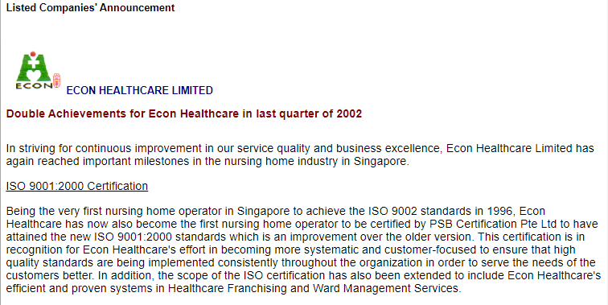
Case Study Healthcare Sector (cont.)

Slide 22
3
1
Enhanced patient safety and quality of care
Regulatory compliance
Hospitals operate within a highly regulated environment, with strict requirements related to patient care, privacy, and information security. ISO certifications, such as ISO/IEC 27001 (Information Security Management System) and ISO 13485 (Medical Devices Quality Management System), help hospitals ensure compliance with regulatory standards, maintain patient confidentiality, and manage medical device safety effectively.
ISO standards such as ISO 9001 (Quality Management System) and ISO 15189 (Medical Laboratory Quality Management) promote patient safety and improved quality of care. Implementing these standards helps hospitals establish robust processes, minimize errors, and deliver consistent, high-quality healthcare services. It ensures that patient safety is prioritized and that clinical practices align with recognized standards.
Specific Benefits of ISO for the Healthcare Sector
4
2
Improved operational efficiency
Patient satisfaction and trust
ISO standards emphasize process optimization and efficiency. By implementing ISO guidelines, hospitals can streamline their operations, reduce waste, and improve resource management. This leads to shorter patient wait times, enhanced staff productivity, and overall operational efficiency.
ISO certification signals a hospital's commitment to quality, patient safety, and continuous improvement. It enhances patient confidence and trust in the healthcare provider. Patients are more likely to choose a hospital with ISO certification, as it demonstrates adherence to internationally recognized standards and a focus on delivering excellent care and positive patient experiences.

Slide 23
5
Interoperability and collaboration
ISO certifications related to health information management, such as ISO/IEC 27001 and ISO 27799 (Health informatics - Information security management in health using ISO/IEC 27002), promote interoperability and secure exchange of health data. This enables hospitals to collaborate more effectively with other healthcare providers, share patient information securely, and improve care coordination.
6
Specific Benefits of ISO for the Healthcare Sector
Effective risk and emergency management
ISO standards incorporate risk-based thinking and help hospitals identify, assess, and mitigate risks. This includes managing risks related to patient safety, information security, and operational disruptions. Implementing ISO risk management frameworks enhances a hospital's ability to proactively address potential risks, minimize adverse events, and respond effectively to emergencies.
7
Continuous learning and improvement
ISO standards incorporate risk-based thinking and help hospitals identify, assess, and mitigate risks. This includes managing risks related to patient safety, information security, and operational disruptions. Implementing ISO risk management frameworks enhances a hospital's ability to proactively address potential risks, minimize adverse events, and respond effectively to emergencies.

Slide 25
Be an ambassador – and a teacher

Slide 26
Q&A

Slide 27
Thank you!
rinskeg@businessasusual.com.au
Rinske Geerlings
About MSECB
MSECB is accredited by IAS to offer audit and certification services for a wide range of ISO Standards. If you are interested to certify your management systems start by getting a Free Quote.
Stay updated!

